Slide 1



ARVAL BIKE LEASE
INFORMATION PACKAGE
For the many journeys in life

Slide 2
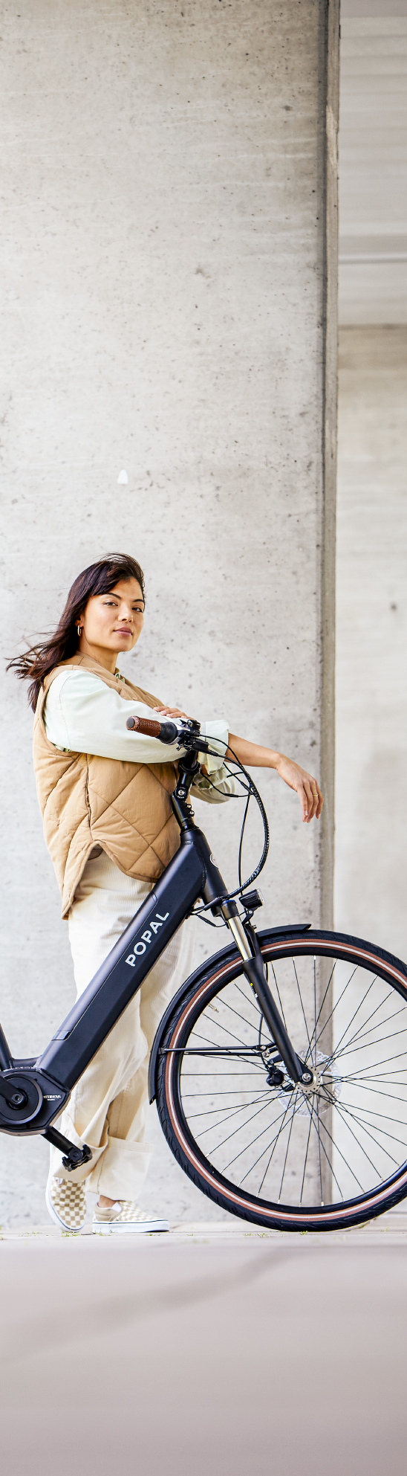






LEASE YOUR NEW BIKE WITH ARVAL
Did you know that your employer gives you the opportunity to lease a bike through Arval? Unlike under the terms of old bike plan, you can choose to use this bike solely for private purposes. You will incur an additional tax liability of 7% of the purchase price of the bike, which amounts to only a few Euros a month!
If you lease your bike through your employer, you’ll usually come out better off than when you buy the bike. This comes largely through a fiscal advantage which can lead to savings of up to 40%. The lease costs are integrated into your gross salary. It’s easy to calculate your advantage on your own.
Are you going to bike more often?
CHECK OUT OUR CALCULATOR TO SEE WHAT THIS CAN MEAN FOR YOU.
CLICK
HERE
BENEFITS OF AN ARVAL LEASE BIKE
From e-bike to cargo bike, race bike, speed pedelec or more
Maintance, repairs and insurance and ANWB roadside assistance included
Fiscal benefits through link to gross salary
Takeover the bike at end of contract or hand it in
Commuting by bike is not mandatory – Full private use is allowed
For the many journeys in life

Slide 3
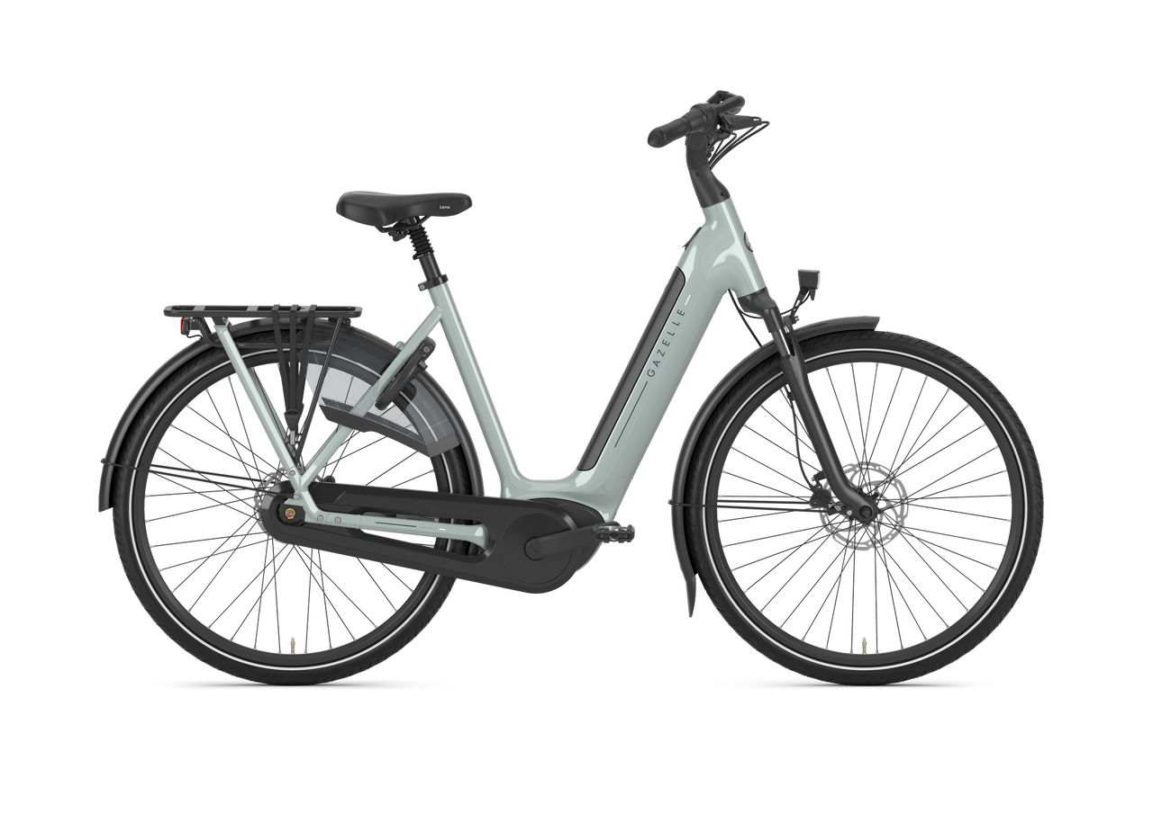
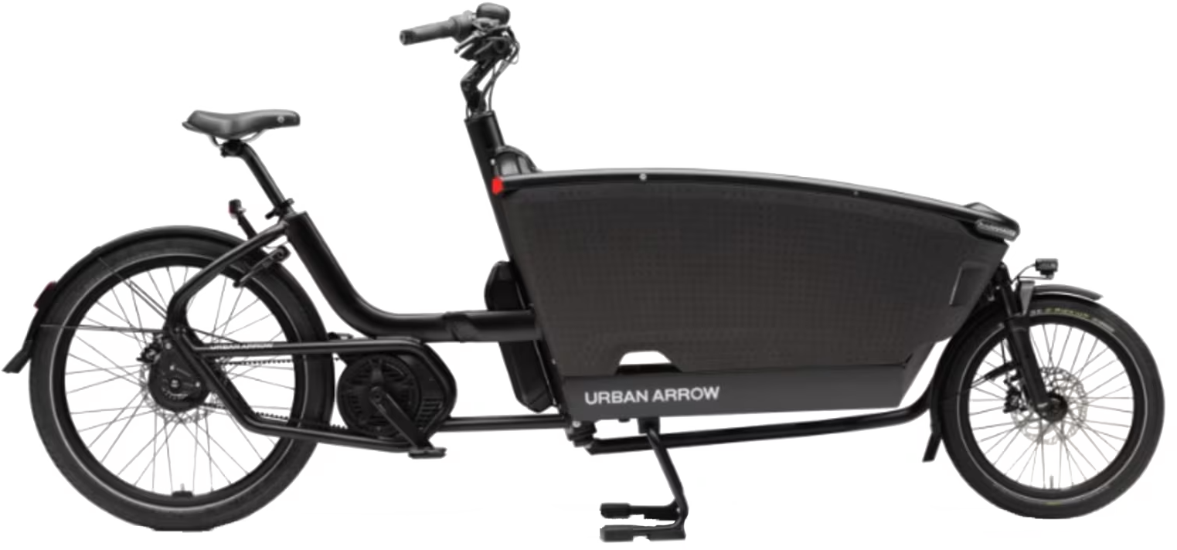
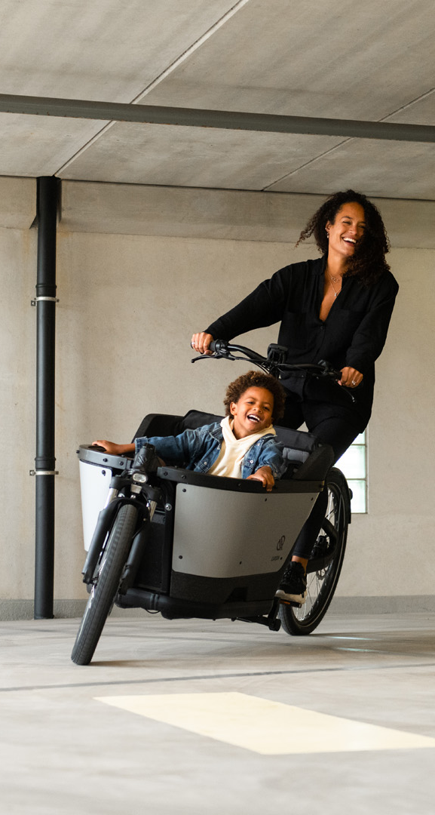
HOW MUCH DO YOU SAVE IF YOU LEASE WITH ARVAL?
Save 24%
Private purchase
All-in lease
Purchase price
€ 2.449,-
N/A
Net costs to employee
-
€ 2.122,-
Service & Insurance
€ 1.058,-
Included
Takeover price (est.)
-
€ 546,-
Total costs (est.)
€ 3.507.-
€ 2.668,-
Private purchase
All-in lease
Save 25%
Purchase price
€ 6.299,-
N/A
Net costs to employee
-
€ 4.245,-
Service & Insurance
€ 1.308,-
Included
Takeover price (est.)
-
€ 1.405,-
Total costs (est.)
€ 7.607.-
€ 5.650,-
DID YOU KNOW…
…that if you cycle regularly, you have higher productivity?
…that if you cycle regularly, you’ll be sick less often – by up to 2 days a year?
…that the average commuting distance in the Netherlands is 15 kilometers?
…that if you bike 6 kilometers to work, you produce 11 times less C02 than if you would have taken the car?
…that you’ll never have to be in a traffic again?
…that you can use the bike 100% for private use?
For the many journeys in life

Slide 4



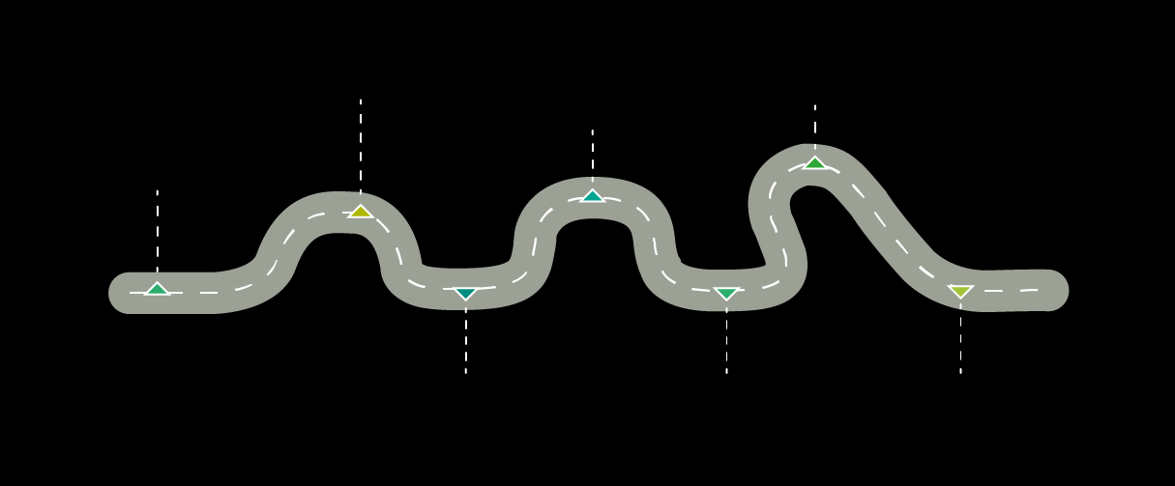





HOW DOES THE ORDER PROCESS WORK?
RECIVE PIN CODE
TO ORDER
ORDER YOUR
BIKE
APPROVAL FROM ARVAL AND EMPLOYER
WELCOME MAIL
CALCULATE YOUR
SAVINGS
ACCEPT THE TERMS
OF USE
PICK UP BIKE
WITH PIN CODE
FREQUENTLY ASKED QUESTIONS BY EMPLOYEES
Do I lose reimbursement for the kilometers I ride by bike to work?
How long is the lease contract?
Yes, only for the kilometers that you travel on your lease bike to work. If you use your bike for travel to work, your employer probably compensates you with a contribution to your monthly lease costs.
Your lease agreement is 36 months. After 36 months, you get the opportunity to purchase your lease bike.
What happens if I leave the company earlier?
What comes with in lease bike package?
If you cancel your lease before the end of the contract, you’ll pay a one-month lease fee as an early exit charge. When you’ve had the bike for less than a year, you’ll also need to cover the remaining months until the 12-month mark. After that, we might offer you the option to buy the bike. You're allowed to transfer your contract to a coworker free of charge. In case you change jobs, you might be able to transfer your lease to your new employer.
Your bike is insured against damage and theft. You also have roadside assistance from the Dutch Touring Association (ANWB) if you need it. All maintenance and repairs are included in the agreement. If you lease a speed pedelec, then you also get a third-party liability insurance. Standard features include a sturdy chain lock as well as a helmet in the case of a pedelec.
For more information, check the bike lease scheme of your employer
For the many journeys in life

Slide 5



















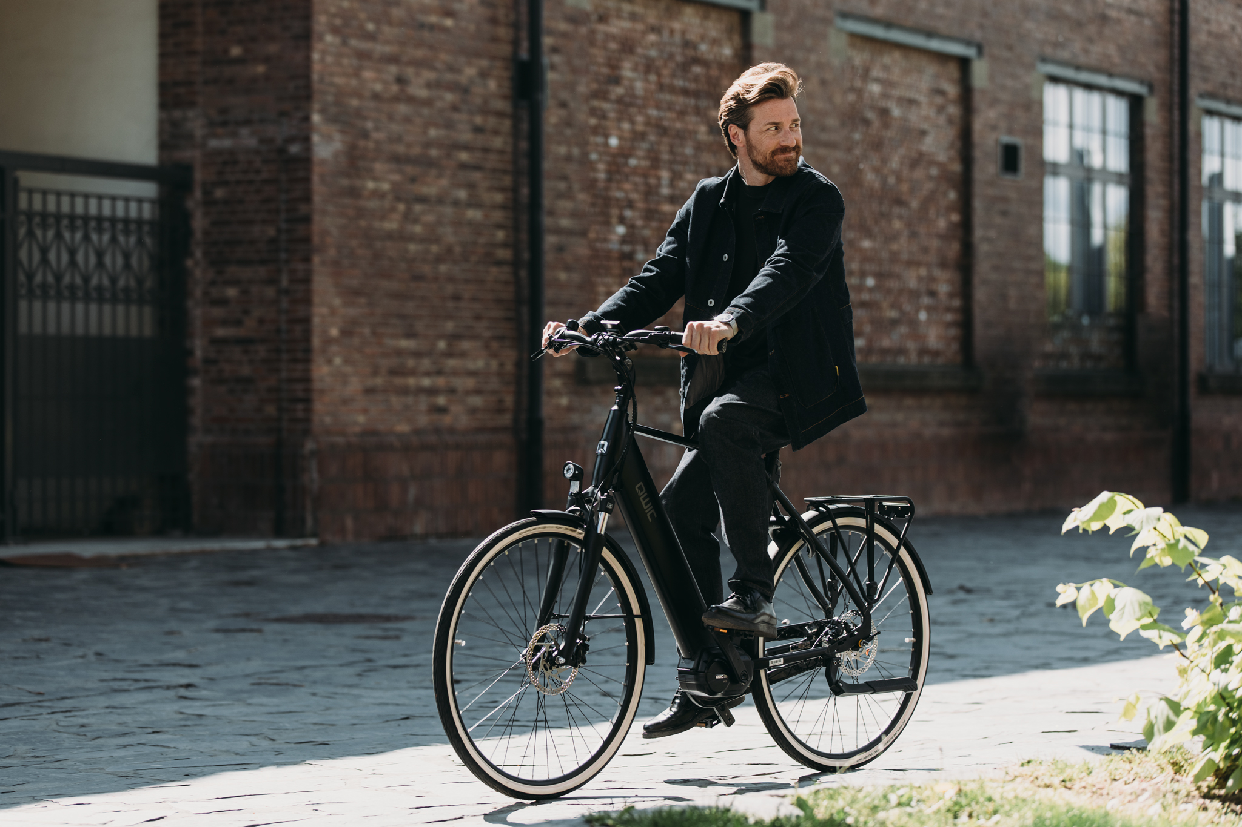
CHOOSE FROM MORE THAN 200 BRANDS AND ALL TYPES OF BIKES!
CHECK THE ENTIRE ASSORTMENT
CLICK HERE
For the many journeys in life

Slide 6




ALL INFORMATION TO BE FOUND ON THE INFORMATION PAGE
QR-CODE
Any questions?
This is how you contact us!
020-2625990
mobility@arval.nl
www.arval.nl
For the many journeys in life

Slide 7


For the many journeys in life

