Slide 1

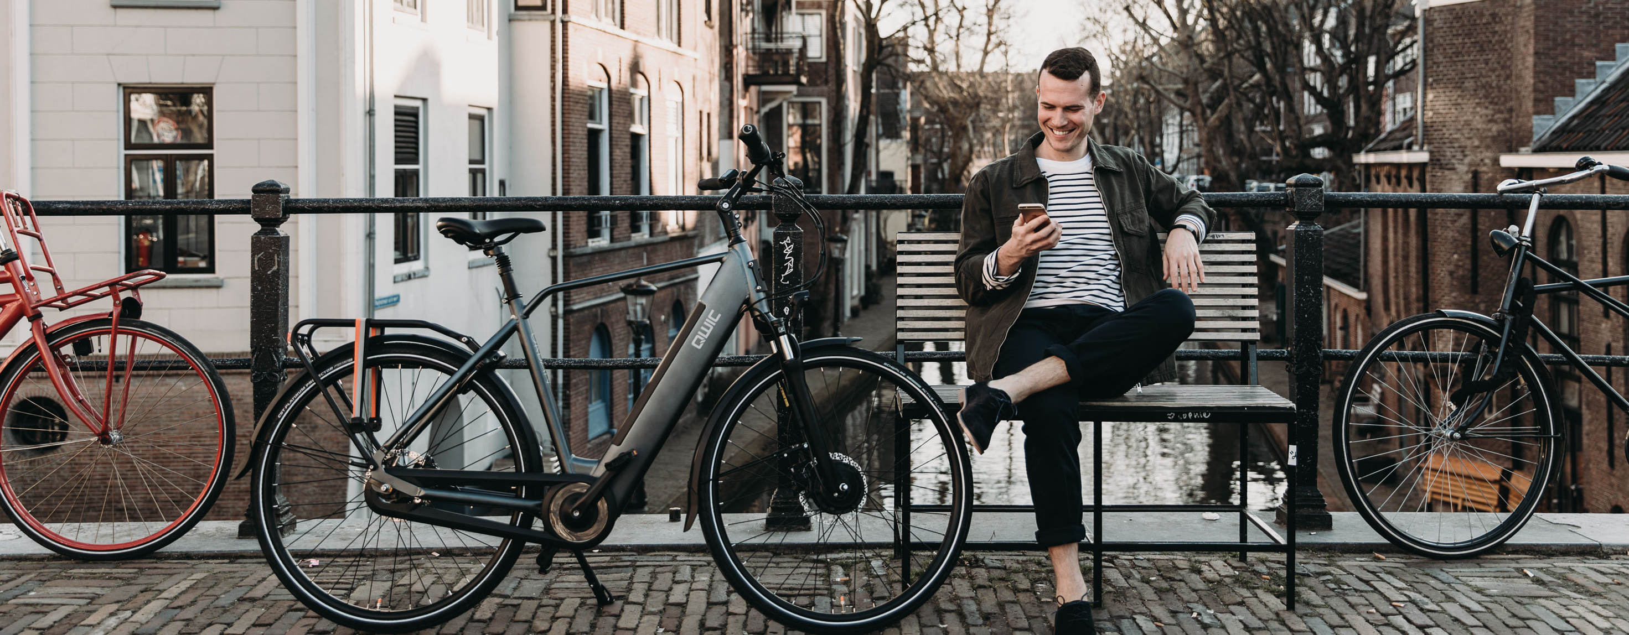

ARVAL BIKE LEASE
For the many journeys in life

Slide 2
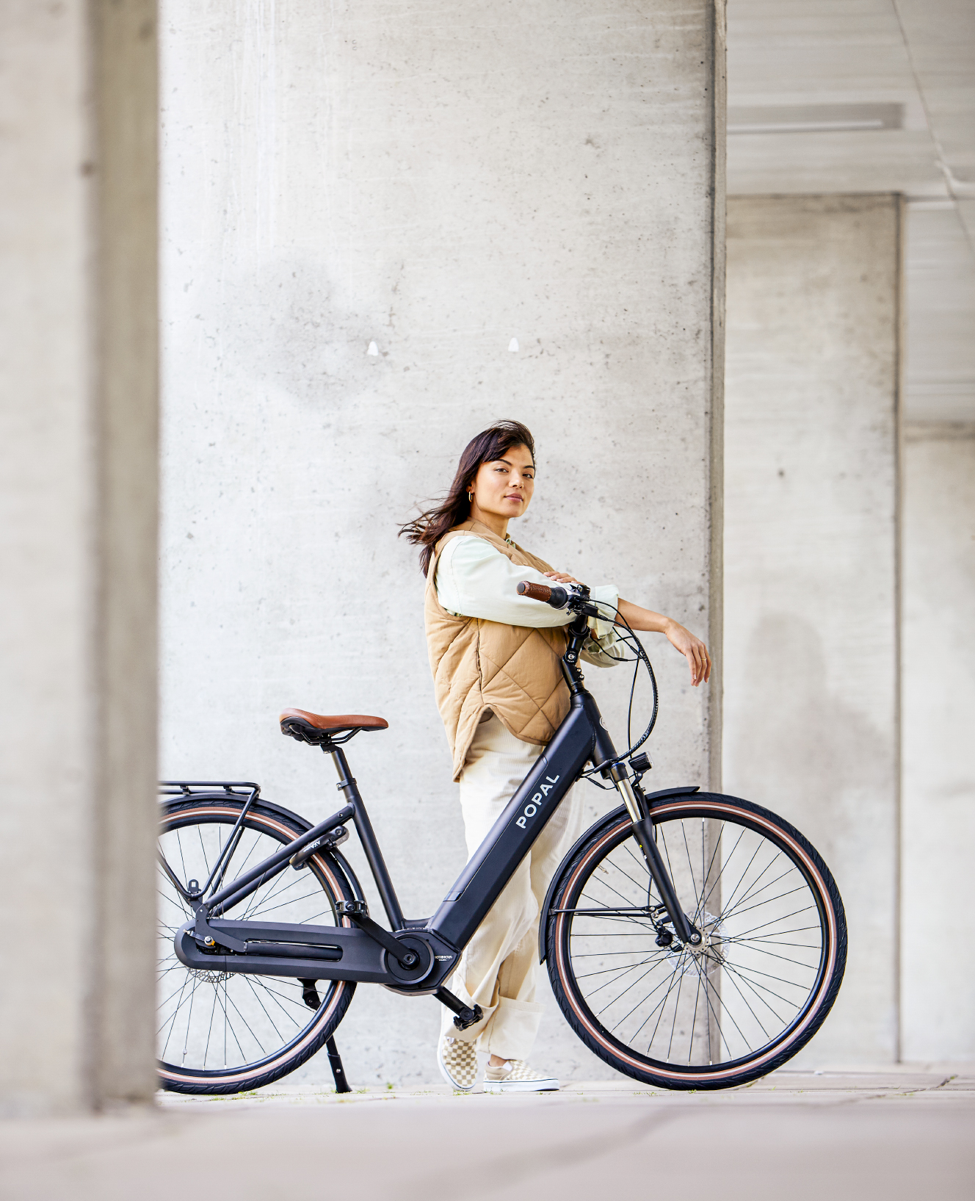

THE BENEFITS
LEASING IS CHEAPER THAN BUYING
NO MANDATORY MINIMUM NUMBER OF COMMUTING TRIPS REQUIRED (7% BENEFIT-IN-KIND)
TAX ADVANTAGE THROUGH PAYMENT FROM GROSS SALARY
TAKE OVER THE BIKE AT THE END OF THE CONTRACT OR RETURN IT
NO BKR REGISTRATION
NO WORRIES ABOUT MAINTENANCE, REPAIRS, THEFT/DAMAGE OR ROADSIDE ASSISTANCE

Slide 3
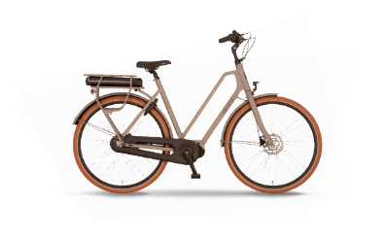
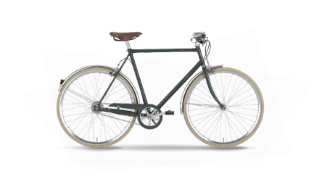
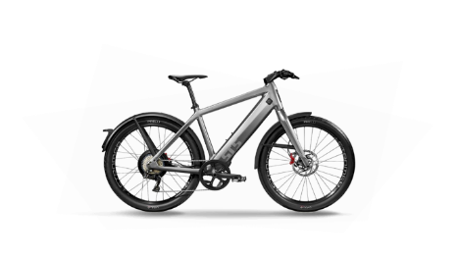
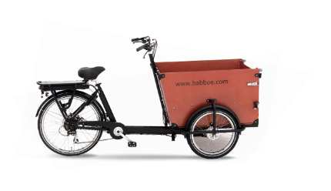













200+ BRANDS
E-BIKE
CITY BIKE
SPEED -PEDELEC
E-CARGO-BIKE

Slide 4
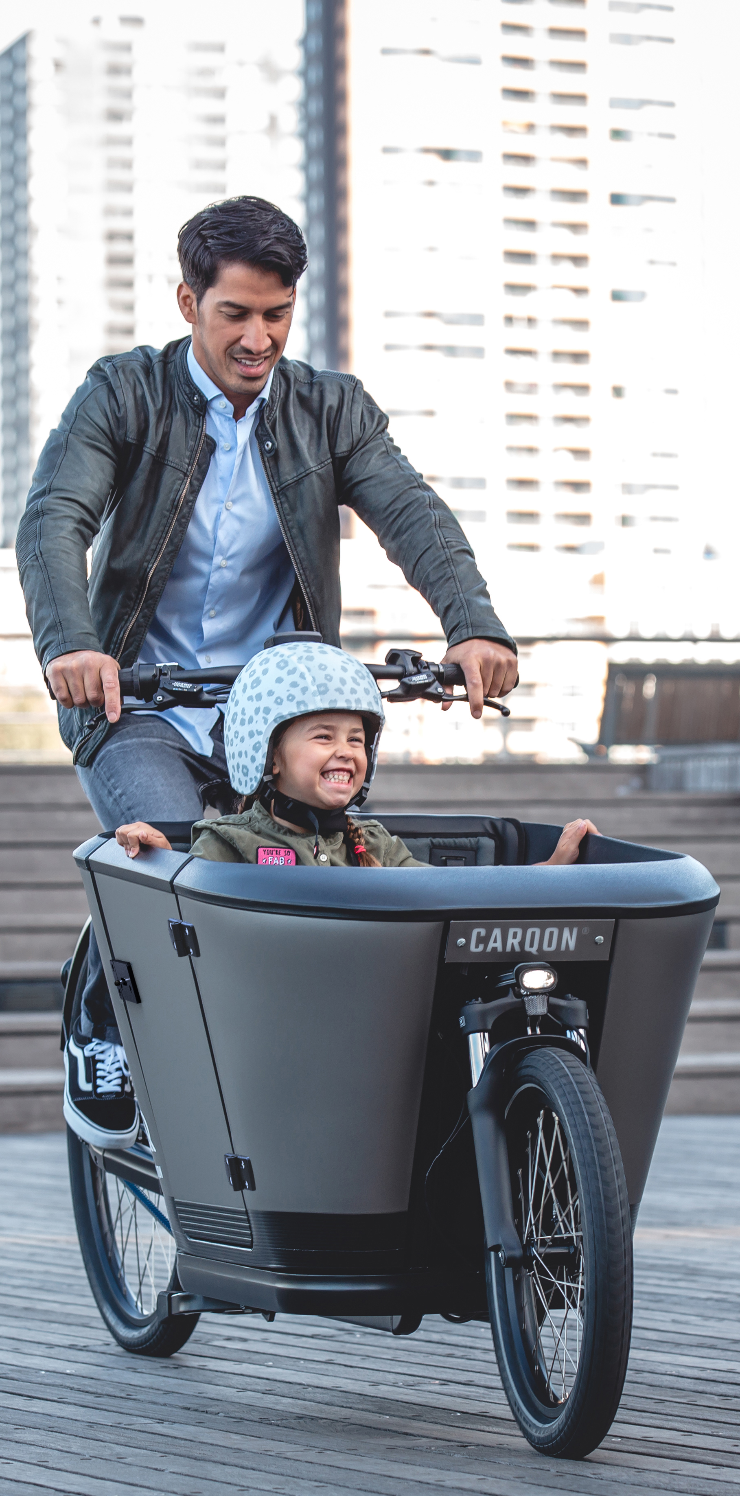




SERVICES
ALWAYS A
RELIABLE BIKE
INSURED AGAINST THEFT AND DAMAGE
ROAD
ASSISTANCE
Maintenance
Repairs
Replacement bike
ART-2 approved bike lock
Reduced excess
Third-party liability insurance
24/7 roadside assistance
Repairs included
Coverage throughout the Nederlands

Slide 5
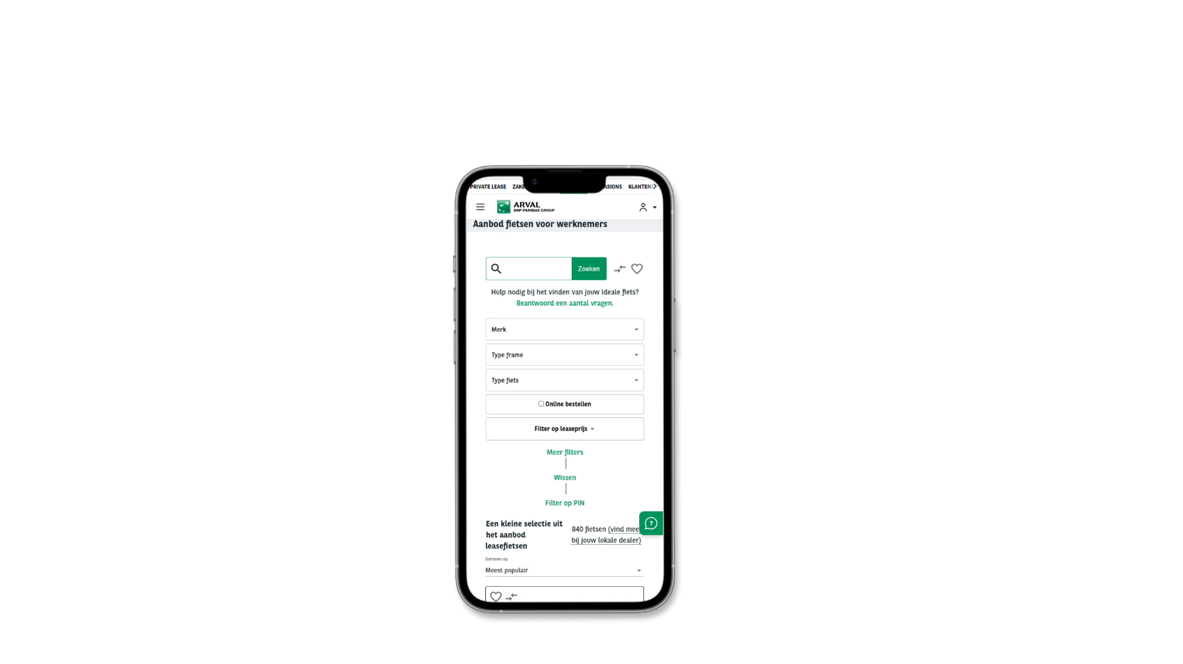

TERMS & CONDITIONS
EMPLOYER CONTRIBUTION
€ 50,- PER MONTH – MAXIMUM 1 FIETS LEASEN
MAXIMUM LEASE PRICE
THERE IS NO MAXIMUM LEASE PRICE
ALL PERMANENT EMPLOYEES CAN PARTICIPATE (ALSO IF YOU HAVE A LEASE CAR OR MOBILITY ALLOWANCE)
NO IMPACT ON HOLIDAY ALLOWANCE OR PENSION ACCRUAL
QR-CODE INFORMATIEPAGINA
TRAVEL ALLOWANCE
YOU RECEIVE A GROSS TRAVEL ALLOWANCE ON THE DAYS YOU COMMUTE TO THE OFFICE BY LEASE BIKE
Read more about the scheme on the information page

Slide 6
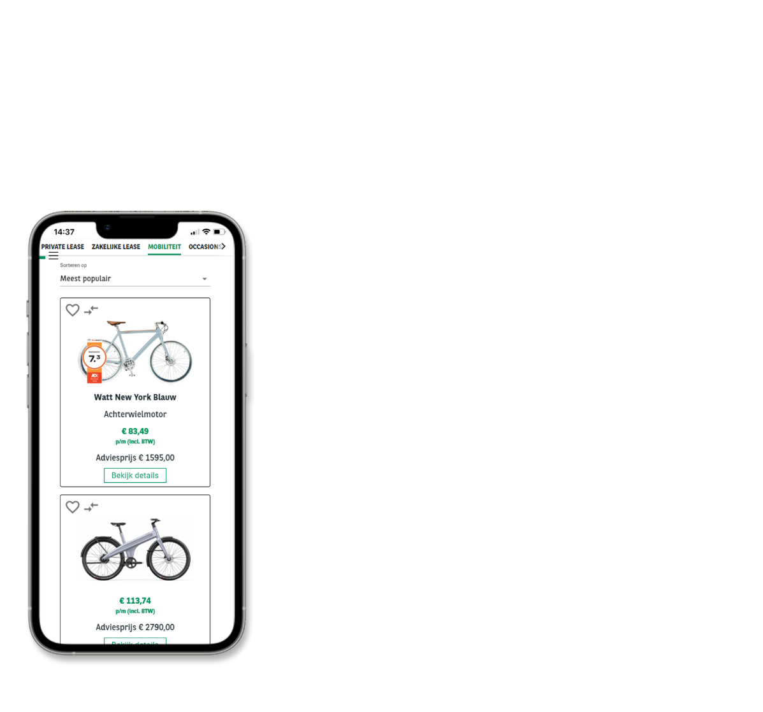
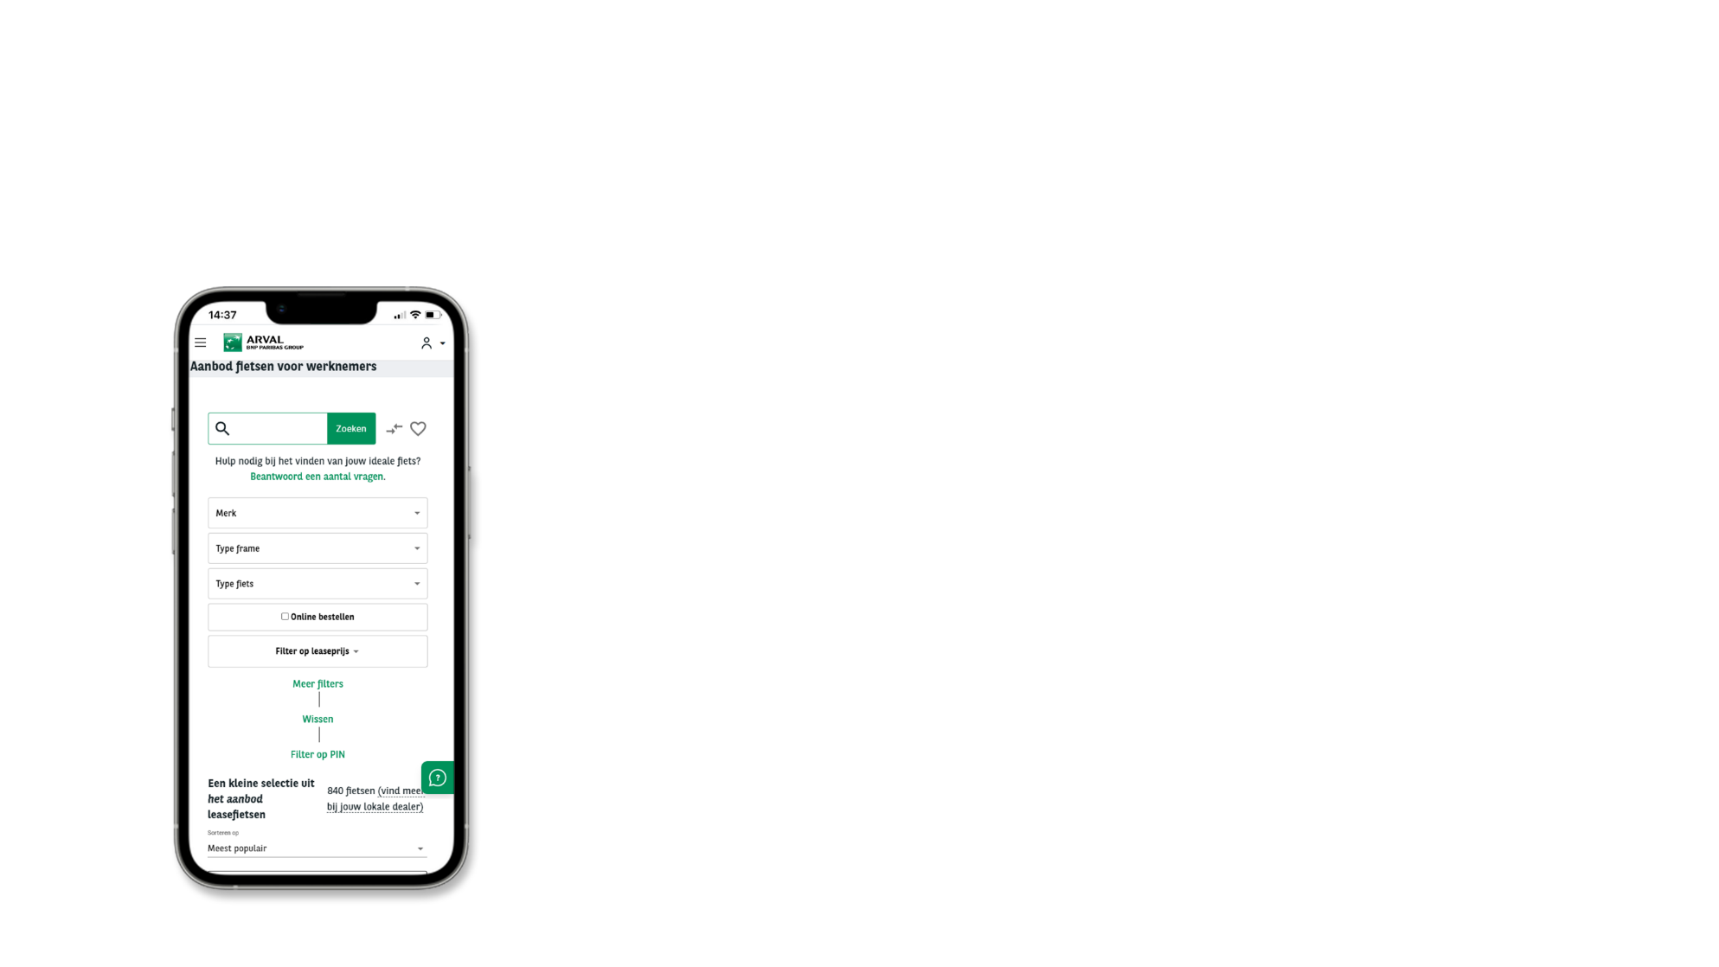
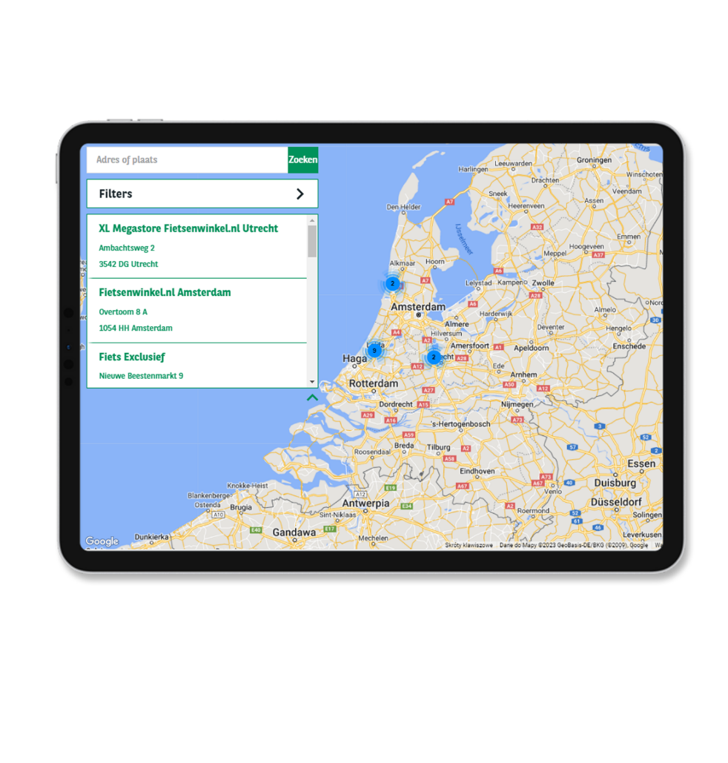
CATALOGUE & DEALER LOCATOR

Slide 7
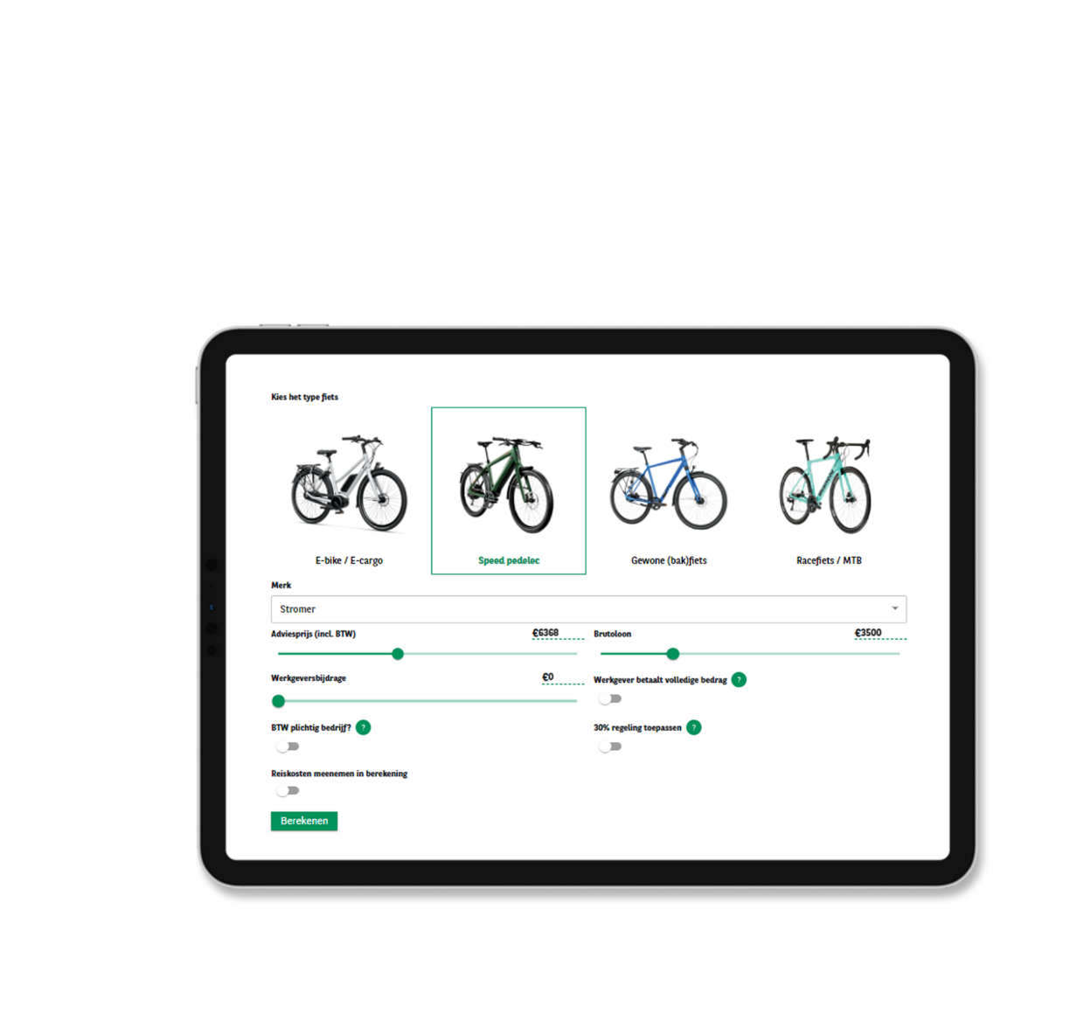
ONLINE CALCULATOR
QR-CODE INFORMATION PAGE

Slide 8
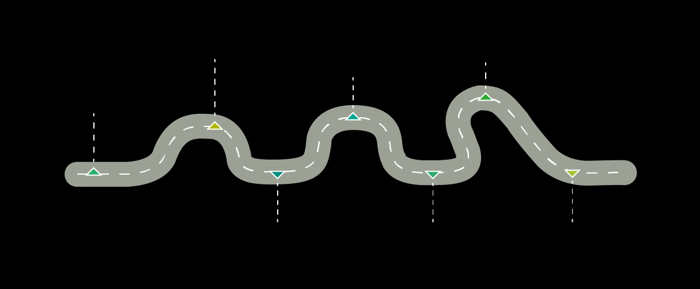







ORDER PROCESS
RECEIVE PIN CODE
TO ORDER
ORDER YOUR BIKE
APPROVAL BY ARVAL AND EMPLOYER
REGISTER
QR-CODE INFORMATION PAGE
CALCULATE YOUR BENEFIT ONLINE
PICK UP BIKE WITH PIN CODE
ACCEPT TERMS & CONDITIONS

Slide 9
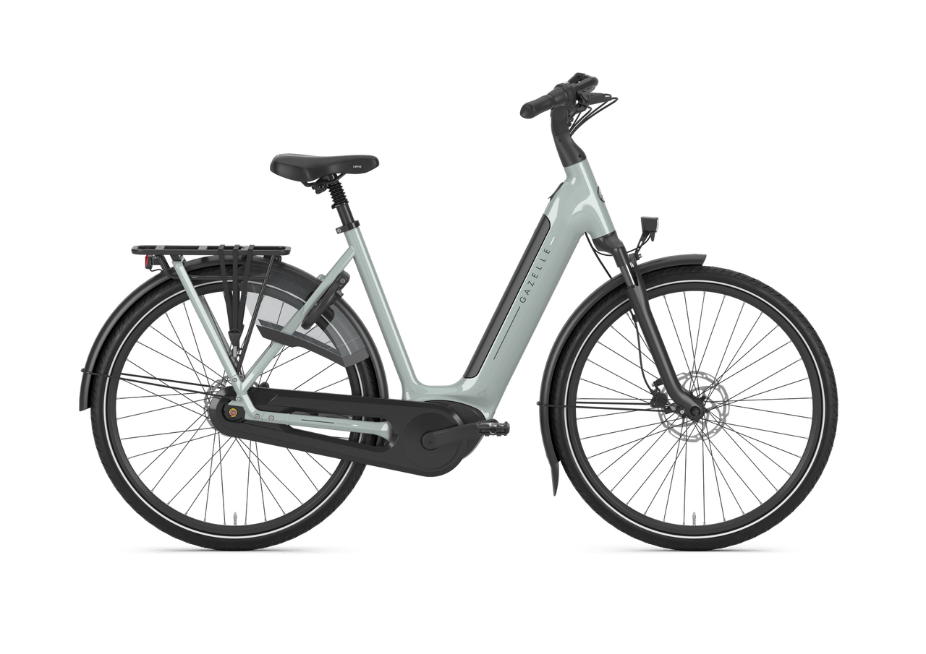
EXAMPLE CALCULATION
Without lease bike
With lease bike
Gross monthly salary
€ 3.500,00
€ 3.500,00
Employer contribution
-
€ 50,00
7% benefit-in-kind
-
€ 14,58
Lease price (all-in)
-
€ -113,74
New gross salary
€ 3.500,00
€ 3.450,84
Tax
€ -610,16
€ -589,73
7% benefit-in-kind
-
€ 14,58
Recommended retail price:
€ 3.399
Net salary
€ 2.889,84
€ 2.846,53
Your monthly net cost:
-
€43,31

Slide 10



Any questions?
This is how you can contact us!
QR-CODE INFORMATION PAGE
020-2625990
mobility@arval.nl
www.arval.nl

